Slide 1
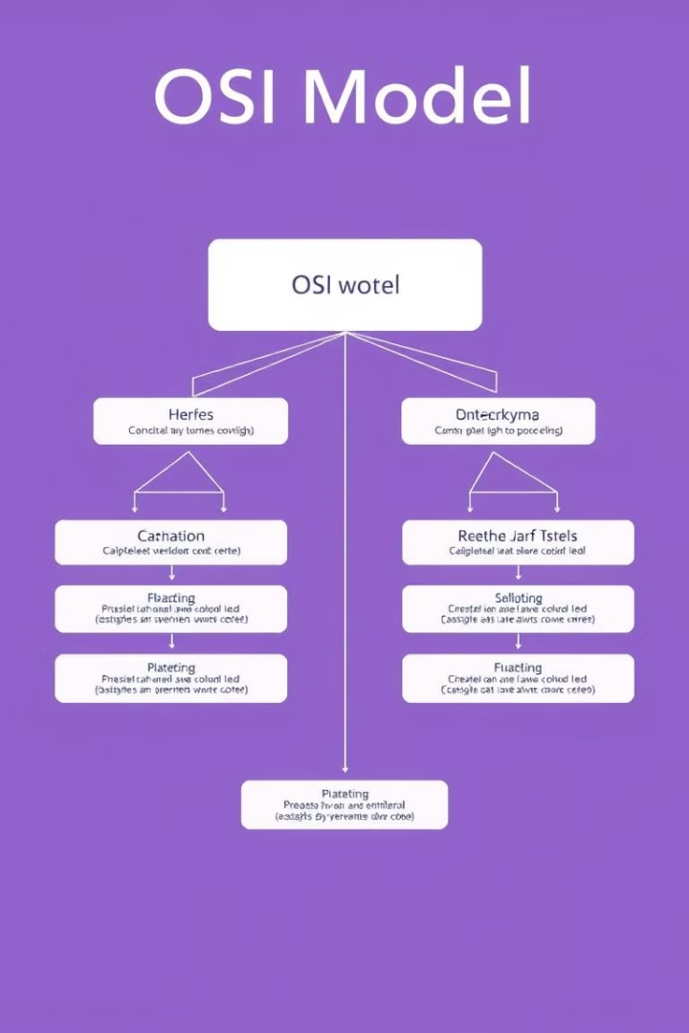

OSI Model and Protocol
An exploration of the OSI model and its various layers, as well as the role of protocols in network communication
by S Shabareesh

Slide 2
Introduction to the OSI Model
Structure
Standardization
Seven layers, each with specific tasks, working together for seamless communication
A reference model that standardizes network communication, ensuring compatibility

Slide 3




Application Layer
User Interface
Provides the user interface for accessing network services, including web browsers and email clients
Network Services
Accesses network services like email, file transfer, and web browsing
Protocol Interaction
Interacts with lower layers of the OSI model to transmit and receive data

Slide 4

Presentation Layer
1
Data Format
Translates data into a format that can be understood by the receiving application
2
Encryption
Encrypts and decrypts data for secure transmission, ensuring data privacy
3
Compression
Compresses data for efficient transmission, reducing bandwidth usage

Slide 5



Session Layer
Synchronization
2
Ensures data is exchanged in the correct order, preventing issues with timing
Dialog
Manages communication sessions, including establishing, coordinating, and terminating sessions
1
Checkpoint
Saves data at specific points in the session, allowing for recovery in case of failures
3

Slide 6




Transport Layer
Connection
Segmentation
Error Control
Establishes and manages connections between applications on different devices
Divides data into segments for efficient transmission, ensuring reliable delivery
Provides flow control and error handling to ensure data integrity

Slide 7

Network Layer
Routing
Addressing
Determines the best path for data to travel across the network
Adds IP addresses to data packets for network-wide communication
Fragmentation
Divides large packets into smaller fragments for easier transmission

Slide 8
Data Link Layer
Error Detection
Addressing
Detects and corrects errors in the physical layer transmission
Adds MAC addresses to data frames, ensuring data is sent to the correct device

Slide 9

Physical Layer
Transmission
Media
Converts data into electrical signals for transmission over physical media
Handles physical aspects like cable types, connectors, and signal strength

Slide 10

Protocol and It's Types
Definition
A set of rules that govern communication between devices on a network, ensuring interoperability
Types
Various types of protocols exist, each designed for specific network tasks
Examples
TCP/IP, HTTP, FTP, SMTP, and DNS are commonly used protocols

Slide 11

Thank You
Thank you for your time.
I hope this presentation helped you better understand the OSI model and protocols.

